Slide 1
CS- Computer Vision
Anwar Khan
Department of Computer Science University of Lahore
Notes:
https://introtocv.github.io/materials.html
Top computer vision conferences and papers:
CVPR: IEEE Conference on Computer Vision and Pattern Recognition
ICCV: International Conference on Computer Vision
ECCV: European Conference on Computer Vision
NeurIPS: Neural Information Processing Systems

Slide 2


Overview
1 Introduction
Introduction Digital Image
Digital Image Processing
Fundamental Steps in Digital Image Processing
Image Aquisition Image Enhancement Image Restoration
Morphological Processing
Segmentation
Representation and Description Object Recognition
2

Slide 3
Introduction
”One picture is worth more than ten thousand words.”
- Anonymous
Introduction

Slide 4
Digital Image
Defination
Digital Image -
A two dimensional function f (x, y ) x and y are spatial coordinates
The amplitude of f is called intensity or gray level at the point (x, y )
Picture Elements/image Elements/Pels/Pixels
Intensity 85
Introduction

Slide 5
A simple image formation model
f (x,y ): intensity/brightness of the image at spatial coordinates (x , y)
f(x,y) = i(x, y) r(x, y) 0 ≤ f(x, y) < ∞
Illumination component i(x , y):
The amount of source illumination incident on the scene.
Reflectance component r(x , y):
The amount of illumination reflected by the object.
Where
0< I (x,y)<∞: Determined by the light source
0< r (x,y)<1: Determined by the characteristics of objects

Slide 6
Digital Image Processing
Digital image processing focuses on two major tasks
Improvement of pictorial information for human interpretation
Processing of image data for storage, transmission and representation for autonomous machine perception
Defination
Process digital images by mean of computer
Some argument about where image processing ends and fields such as image analysis and computer vision start
Introduction

Slide 7
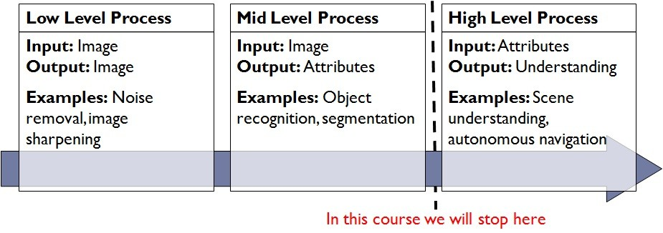
Digital Image Processing
Image processing to Computer Vision
The continuum from image processing to computer vision can be broken up into low-, mid- and high-level processes
Introduction

Slide 8
Classification of DIP and Computer Vision Processes
Low-level process DIP
Noise reduction
Contrast enhancement
High-level process CV
Cognitive decision-making, pedestrian crossing detected, vehicle slows down.
Lane recognition: Vehicle stays in correct lane
Traffic sign recognition: Stop Command.
Mid-level process DIP and CV
Edge Detection
Segmentation and recognition of objects (e.g., Car, Pedestrian, Stop Sign).

Slide 9
Fundamental Steps in Digital Image Processing
Input: Image and Output: Image
Image acquisition Image enhancement Image restoration
Morphological processing
Input : Image and Output: Attributes
Morphological processing Segmentation
Object recognition Representation and description
Introduction

Slide 10
Fundamental Steps in Digital Image Processing
Image Aquisition
Most of the images are generated by the combination of an “illumination” source and the reflection or absorption of energy from that source by the elements of the “scene” being imaged.
Imaging system
Introduction

Slide 11
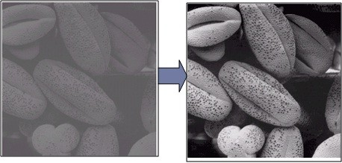
Fundamental Steps in Digital Image Processing
Image Enhancement
Image enhancement is the process of manipulating an image so that the result is more suitable than the original for a specific application.
Introduction

Slide 12
Fundamental Steps in Digital Image Processing
Image Restoration
Repairing old, damaged, or degraded photographs to restore them to their original condition or even improve their visual quality.
Damaged Image
Restored Image
Introduction

Slide 13
Fundamental Steps in Digital Image Processing
Color Image Processing
Color image processing is an area that has been gaining in importance because of the significant increase in the use of digital images over the Internet.
Original Image
Colorized Image
Introduction

Slide 14
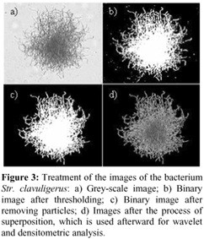
Fundamental Steps in Digital Image Processing
Wavelets
Wavelets are the foundation for representing images in various degrees of resolution.
Introduction

Slide 15
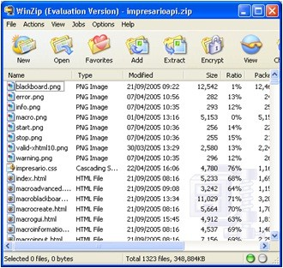
Fundamental Steps in Digital Image Processing
Image Compression
Compression, as the name implies, deals with techniques for reducing the storage required to save an image, or the bandwidth required to transmit it.
Introduction

Slide 16
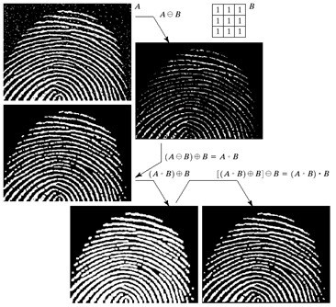
Fundamental Steps in Digital Image Processing
Morphological Processing
Morphological processing deals with tools for extracting image compo- nents that are useful in the representation and description of shape.
Introduction

Slide 17
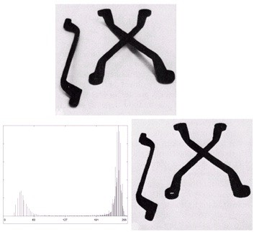
Fundamental Steps in Digital Image Processing
Segmentation
Segmentation procedures partition an image into its constituent parts or objects.
Introduction

Slide 18
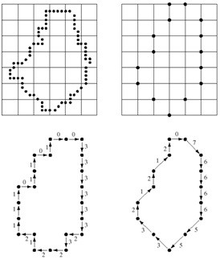
Fundamental Steps in Digital Image Processing
Representation and Description
Representation and description almost always follow the output of a segmentation stage,which usually is raw pixel data, constituting either the boundary of a region (i.e., the set of pixels separating one image region from another) or all the points in the region itself.
Introduction

Slide 19
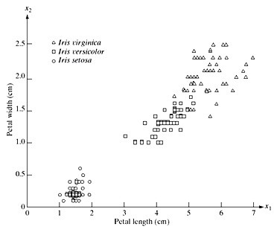
Fundamental Steps in Digital Image Processing
Object Recognition
Recognition is the process that assigns a label (e.g., ”vehicle”) to an object based on its descriptors.
Introduction

Slide 20
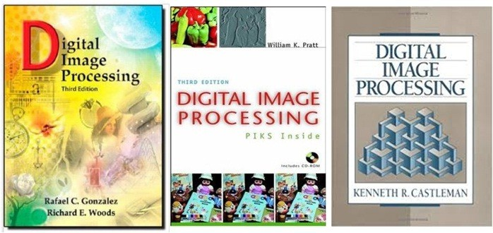
Referred Books
Rafael C. Gonzalez and Richard E. Woods Digital Image Processing
Third Edition
William K. Pratt
Digital Image Processing
Third Edition
Kenneth R. Castleman Digital Image Processing
Introduction

Slide 21
The End

